Slide 2
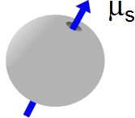

Slide 3
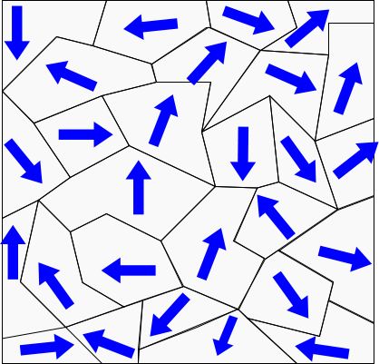
r

Slide 4
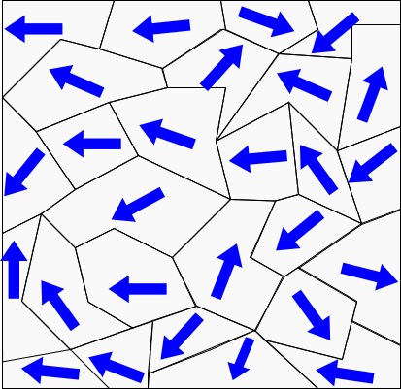

Slide 5
Solenoid approximation
Take two atoms
Their magnetic moments are like having two small current loops next to each other
In between, the currents oppose each other
So in between, it is like having no net current.
I
I
I
I

Slide 6
Solenoid approximation
So the over-all current is like having just the outsides contribute
I
I

Slide 7
Solenoid approximation
Now picture many small current loops
We are left with effective current only on the outside
I
I
I
I
I
I
I
I
I
I
I
I

Slide 8
If we picture the atoms three dimensionally, we have something that looks like layers of current loops
This is just like a solenoid!
I
I
I
I
I
I
I
I

Slide 10
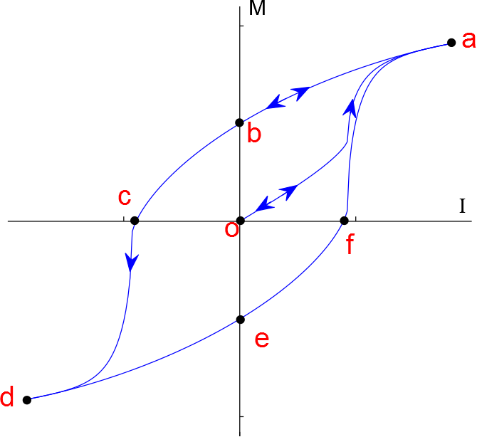
Magnetization Curve

Slide 11
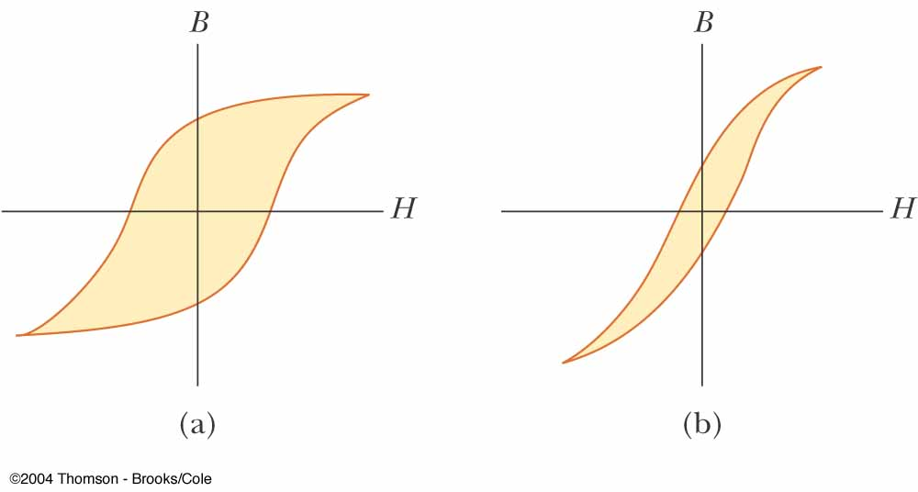
Example Hysteresis Curves
Curve (a) is for a hard ferromagnetic material
The width of the curve indicates a great amount of remanent magnetism
They cannot be easily demagnetized by an external field
Curve (b) is for a soft ferromagnetic material
These materials are easily magnetized and demagnetized

Slide 12
Curie Temperature
The Curie temperature is the critical temperature above which a ferromagnetic material loses its residual magnetism and becomes paramagnetic
Above the Curie temperature, the thermal agitation is great enough to cause a random orientation of the moments
M
Paramagnetic
Ferromagnetic
T
T_{C}

Slide 13
High Potential
Low Potential
E
+ + + + + + + + + + + + + + + + + + + + + + + + + +
+ + + + + + + + + + + + + + + + + + + + + + + + + +
+
A
B
- - - - - - - - - - - - - - - - - - - - - - - - - - - - - -
- - - - - - - - - - - - - - - - - - - - - - - - - - - - - -
d

Slide 14
